Slide 1
Analytics for healthcare data optimization
A project by
Manya Karthik (210701152)
Nitish K (210701183)
Nitish M ( 210701184)

Slide 2
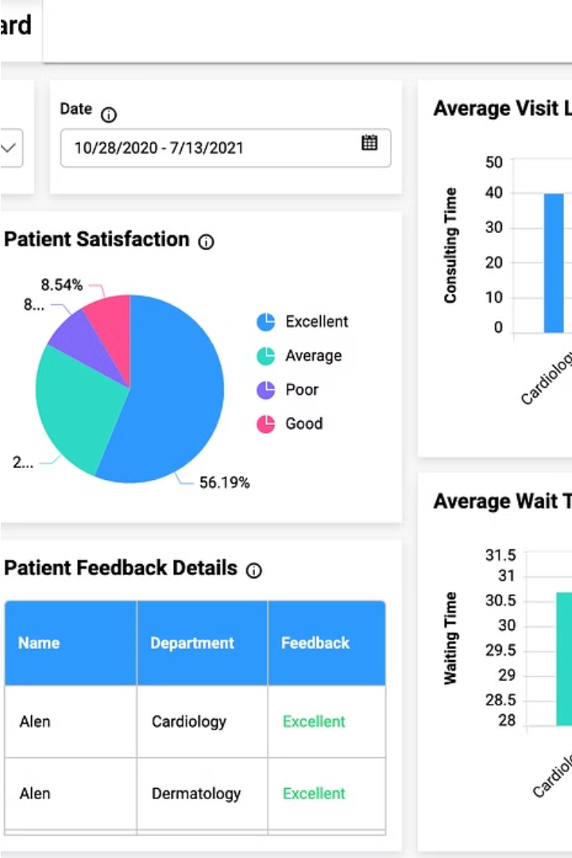
Introduction
In this healthcare analytics project we present a comprehensive analysis of hospital data to enhance healthcare management and improve patient outcomes. Leveraging advanced tools and technologies, including IBM Cognos Analytics, DB2 Database, Excel, Python, Google Colaboratory, and Github, we delve into data-driven insights and recommendations for optimizing resource allocation and patient care.

Slide 3

Objective
The primary objective of this project was to leverage data analytics techniques to enhance healthcare management efficiency in hospitals, with a specific focus on predicting and optimizing patient length of stay. By conducting insightful analyses, the project aimed to empower hospitals to make data-driven decisions regarding resource allocation, ultimately improving patient care and operational workflows. The implementation of predictive models and optimization strategies sought to reduce unnecessary hospital stays, streamline processes, and enhance the overall functioning of healthcare facilities. This approach not only aimed to improve patient outcomes but also to maximize the effective use of hospital resources.

Slide 4
Tools and Technologies
1
IBM Congos Analytics
2
DB2 Database
IBM Cognos Analytics is a business intelligence software that helps organizations make data-driven decisions with tools for data exploration, reporting, and visualization.
IBM Db2 is a high-performance database management system used for storing, managing, and retrieving large volumes of structured and unstructured data.
3
Excel
4
Google Colab
Excel is Microsoft's spreadsheet software, used for data analysis, calculations, and visualization, with features for creating charts and graphs.
Google Colab is a cloud-based platform for developing and running Python code, offering free access to computing resources like GPUs and TPUs.

Slide 5
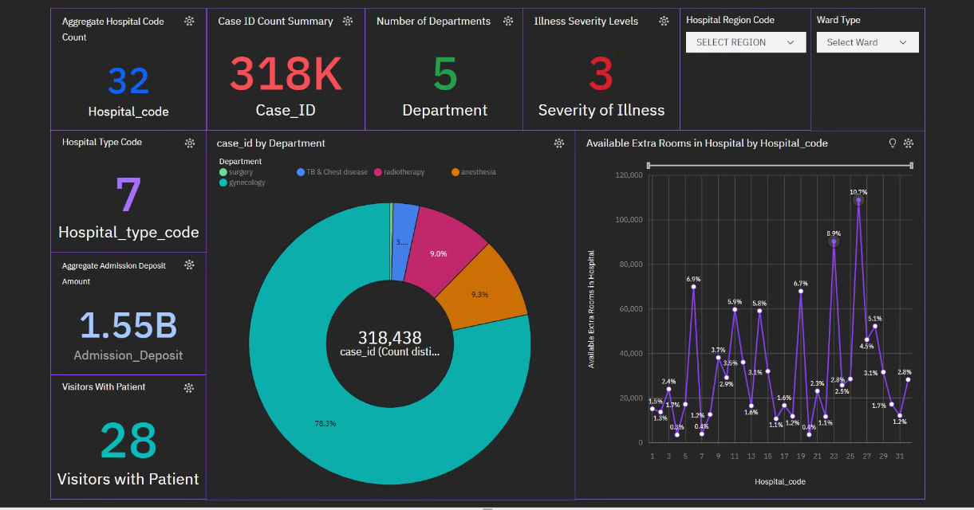
Healthcare Insights Dashboard

Slide 6
Key Findings
Patient Admissions:
Trauma admissions accounted for the highest percentage (30.4%) of patients. Additionally, a small fraction (2.3%) of trauma admissions required stays exceeding 100 days. Prolonged stays were also observed in emergency and urgent admissions, while gynecology cases exhibited a moderate volume with generally moderate severity.
Illness Severity:
Patients with moderate illnesses constituted a larger proportion compared to those with extreme or minor conditions.
Admission Types:
Trauma admissions were frequent, whereas urgent admissions were relatively lower.
Ward Distribution:
Among the five wards, Ward R recorded the highest number of cases, highlighting the need for targeted resource allocation.
Hospital Utilization:
Hospital code 26 stands out with a notable surplus of available rooms, surpassing other hospital types. This observation presents valuable insights into the potential for optimizing capacity and enhancing resource utilization effectively.

Slide 7




Outcome
Data Integration
Analytical Insights
Improved Outcomes
Consolidated disparate data sources into a unified, secure platform.
Leveraged advanced analytics to uncover actionable insights and trends.
Optimized clinical workflows and resource allocation to enhance patient care and organizational performance.
The data-driven healthcare initiative has transformed the organization, leading to improved patient outcomes, enhanced operational efficiency, and a competitive advantage in the market. The insights and strategies developed through this project will continue to shape the future of healthcare delivery.

